Slide 1
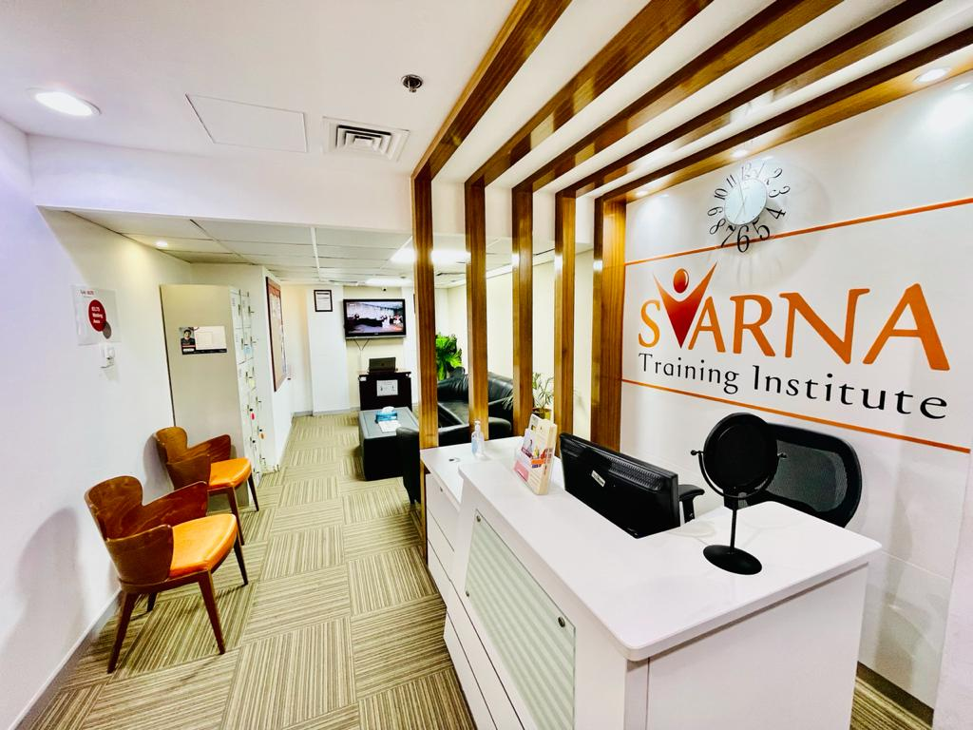
Centre of Excellence “Transform The Vision into Reality”
Engage | Evaluate | Empower
Award Winning Centre from IDP Education Limited Australia
Info@svarnainstitute.com / +971569970868/ +97143882708

Slide 2
OUR VISION & MISSION
VISION OF SVARNA
“To be the best instiller of creative and innovative knowledge and transform the vision into reality.” Our roadmap is designed to empower every individual, to create a better opportunity for themselves and for their industries.
MISSION OF SVARNA
“Our mission is to create competent, capable and dynamic professionals who take training based learning to the next level. We are a team of professionals dedicated to bring in quality to your training needs aimed at soft skill enhancements. We offer superior & sophisticated programs that are at the cutting edge in Training & Development. These programs are globally recognized and are tailor cut and designed to redefine professional paradigms in the Human Resource sector.”

Slide 3
TEST PREPERATION
IELTS
CELPIP
PTE
TOEFL
OET
SAT
GMAT
GRE
ENGINEERING
MEDICAL
“Cambridge International AS Level English General Paper 8021”
LANGUAGE PROGRAMS
ARABIC
FRENCH
BUSINESS ENGLISH
SPOKEN ENGLISH
IT PROGRAMS
AUTOCAD
CLOUD COMPUTING
DEVOPS
DIGITAL MARKETING
LINUX
MS OFFICE
GRAPHIC DESIGNING
WEB DESIGNING
TESTING VENUE FOR IELTS EXAMS
SVARNA is a Award Wining Test venue of 2020 in UAE. We conduct both kind of IELTS test (Computer Delivered & Paper Based)

Slide 4
WHY SVARNA ?
Our Governing Body: Svarna Training Institute does not constitute of just expert educationist but comprises of highly accomplished professionals from diversified fields with great success track record.
Highly qualified, Competent and experienced team of Trainers.
Rated Excellent on Google: Our student Google review and recommendation is testament of our teaching quality.
We have mastery in customizing programs one to one, for candidates / professionals / corporate who need targeted assistance.
Our end-of-course reports not only record the progress participants have made in acquisition of key skills but also measure how their confidence has improved during the course.

Slide 5
SVARNA’S EDGE
Passionate and established experience of around 7+ years
Effective and well-planned teaching hours
SVRANA is an award-winning IELTS center by IDP Australia for 2020; so, known for its quality
Dedicated team of worldwide expert teachers
Progress feedback and test reviews
Track record of Top scores from students
Happy Student and clients
Unparalleled study materials

Slide 6
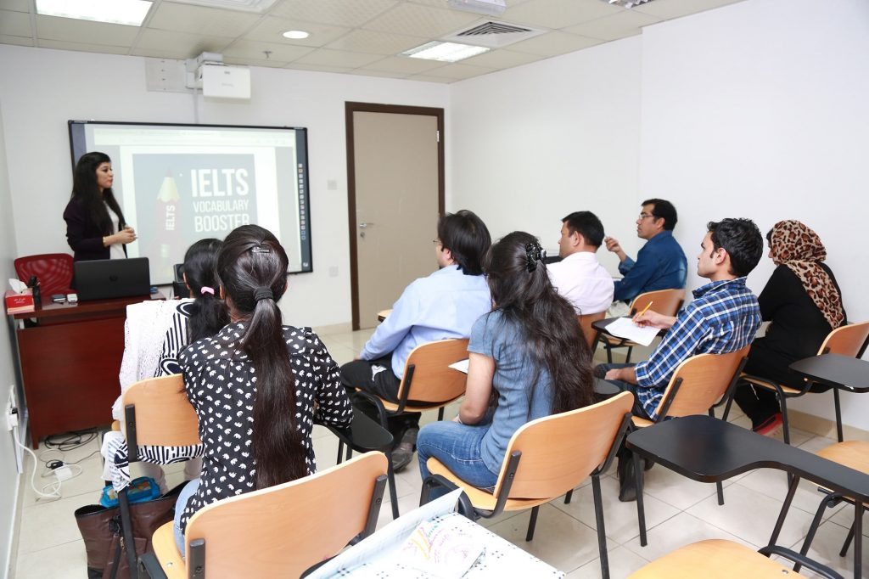
IELTS, PTE, TOEFL,CELPIP & OET @ SVARNA
Specialization at Svarna
Innovative Training
Latest Technologies
Quality Material
Standard, Premium & Platinum Class Batches
Special Training for Computer Delivered IELTS Exam
Result Oriented
Strictly following COVID Guidelines
Our promise to give you 100% Return on Investment
Online & Offline Classes

Slide 7
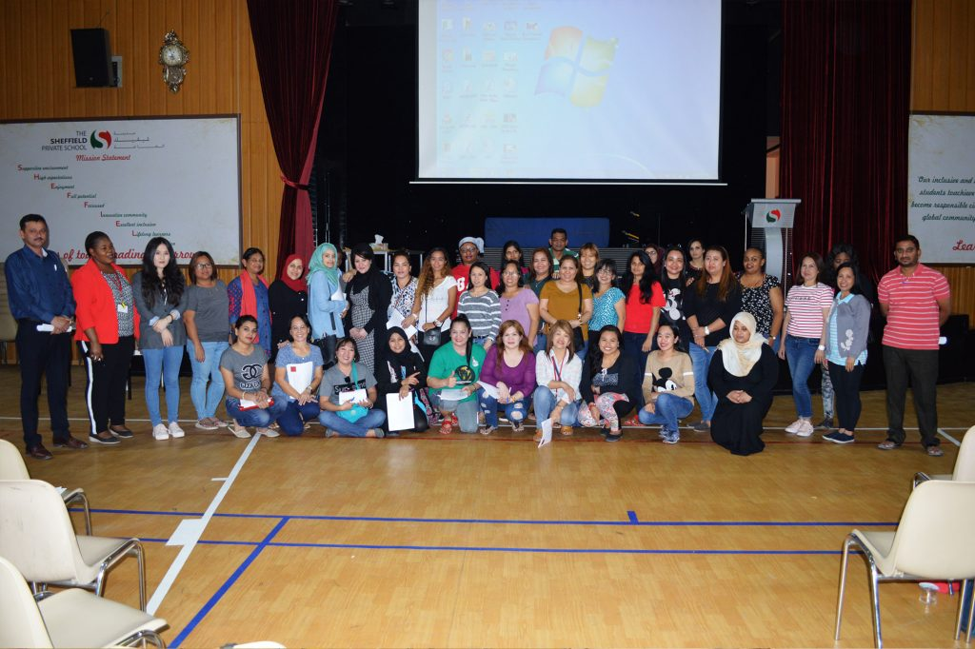
SAT @ SVARNA
At SVARNA, we have completely broken down the complexities and intricacies of these standardized test. Our knowledge and experience of the SAT will help first-time and returning SAT students boost their scores. We have analyzed the exam to prepare a study prep syllabus that’s proven to work. With our track record of success, we have helped thousands of students get enrolled in top-ranked colleges and universities.
No matter what your confidence level with the SAT, we have the learning platform that’s perfectly suited to match your needs. We offer full-length courses as well as the one-on-one guided instruction of expert tutors. We even have Interactive Online Courses that create more flexibility for schedules and learning styles. Whatever the preferred method, we have the learning resources and the instructors to bring your SAT performance to the next level.

Slide 8
OUR OTHER PROGRAMS
MANAGEMENT COURSES
HR
SALES & MARKETING
BUSIENESS ADMINISTRATION
CUSTOMER SERVICE
FINANCE
SOFT SKILL / PROFESSIONAL DEVELOPMENT
IT
LOGISTICS AND SUPPLY CHAIN
HOSPITALITY AND TOURISM
CORPORATE SPCIALIZATION
WE ARE SPECIALIZED IN CUSTOMIZING TRAINING AS PER CLIENT NEED. WE ARE KNOWN FOR INNOVATIVE TRAINING PROGRAMS
SPECIAL COURSES
STRATEGIC MANAGEMENT & LEADERSHIP
PUBLIC RELATION AND CORPORATE COMMUNICATION
TRAIN THE TRAINER
FINANCE COURSES AND CONSULTANCY
IT COURSES
BEHAVIOURAL TRAINING COURSES
For more information about our all courses please visit our website
www.svarnainstitute.com
Info@svarnainstitute.com / +971569970868/ +97143882708

Slide 9
MANAGEMENT COURSES
CORPORATE SPCIALIZATION

Slide 11
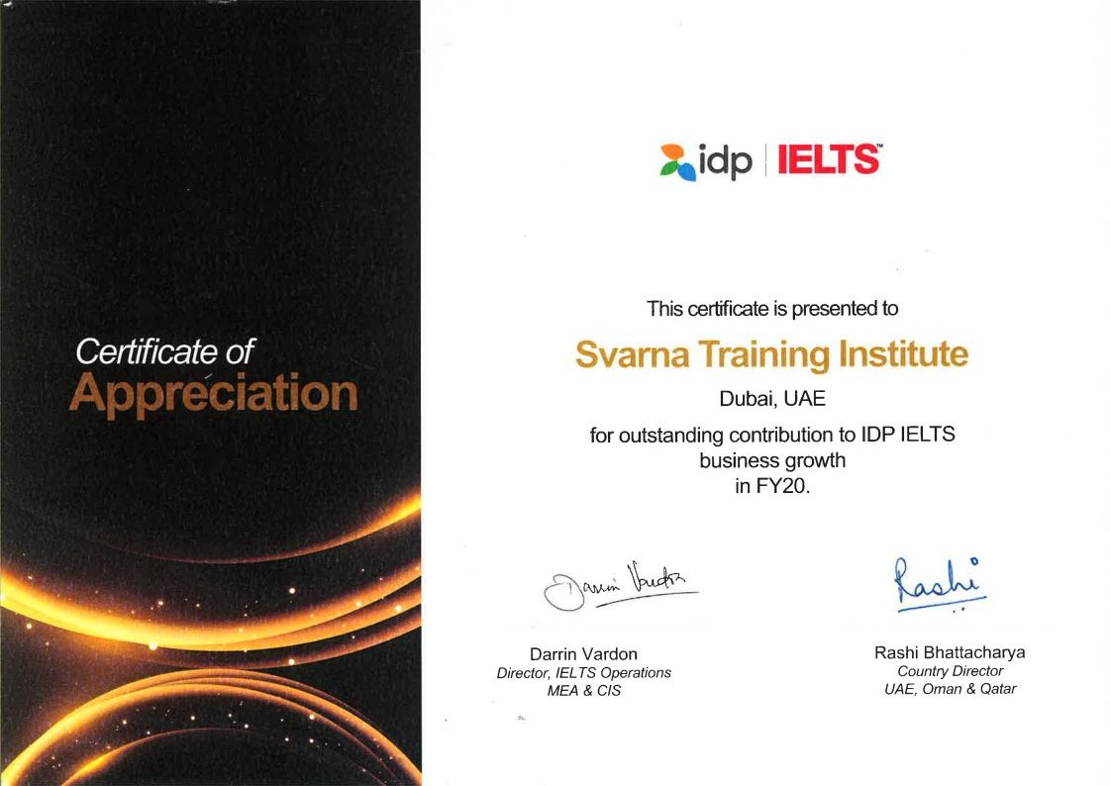

Slide 12
CONTACT US
Svarna Training Institute
Office # 612, AL Khaleej Centre, Near Al Sharaf DG station Exit # 2 Mankhool St,
Bur Dubai P.O Box: 32246 Dubai, UAE
Phone: +971-4-3882708
info@svarnainstitute.com
www.svarnainstitute.com
Thank You
“If mastering a skill requires training, then the training requires quality.”
Info@svarnainstitute.com / +971569970868/ +97143882708

